Slide 1
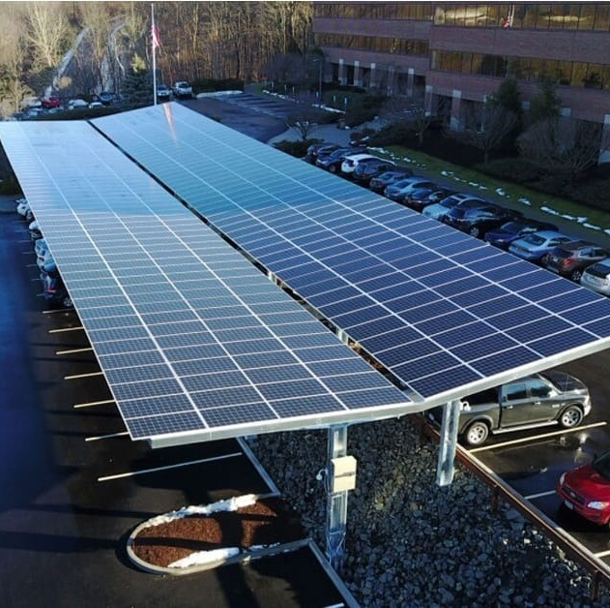
Queens solar carport mounting structure is a specialized framework designed to support and integrate solar panels into a carport, providing a dual-purpose solution of shelter for vehicles and solar energy generation. This innovative system combines clean energy generation with practical infrastructure, offering several key features:
Solar Panel Integration:
The mounting structure is equipped with support rails and brackets designed to securely hold solar panels, optimizing exposure to sunlight for efficient energy generation.
Carport Design:
The structure is configured as a carport, providing shade and shelter for parked vehicles. This dual-functionality maximizes the use of available space.
Weather Resistance:
Built with materials resistant to weather conditions, the structure ensures the longevity and durability of both the carport and solar panels.
Energy Generation:
The solar panels integrated into the structure harness sunlight to generate clean and renewable energy, contributing to reduced reliance on traditional power sources.
Grid Connection:
Many solar carport systems are designed to connect to the electrical grid, allowing excess energy generated to be fed back into the grid or stored for later use

Slide 2
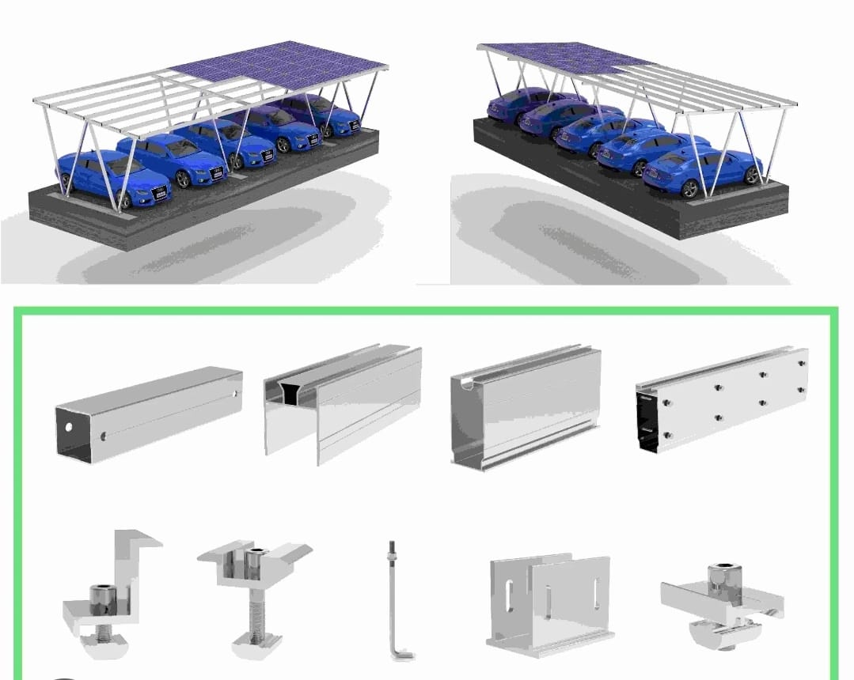
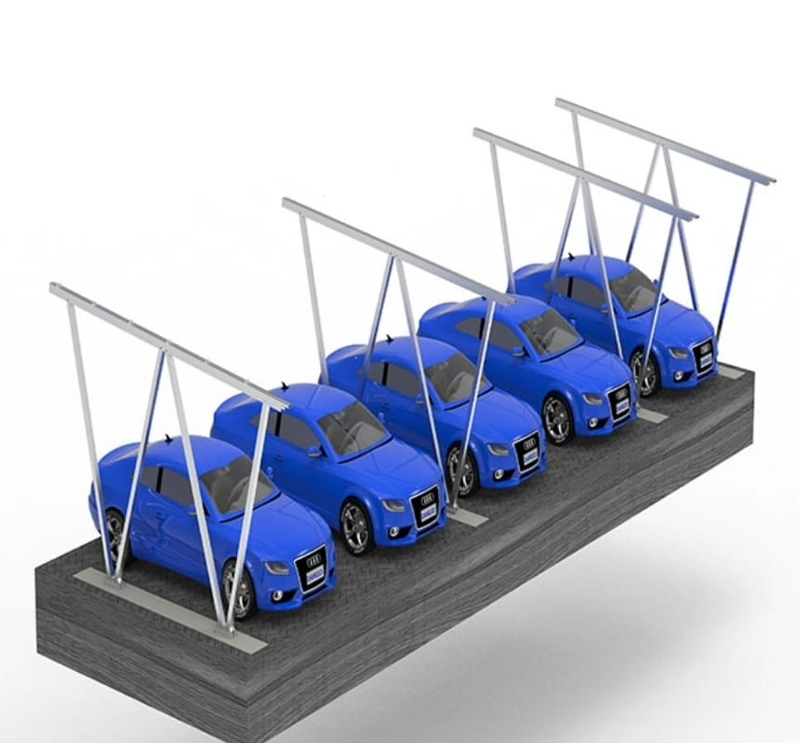
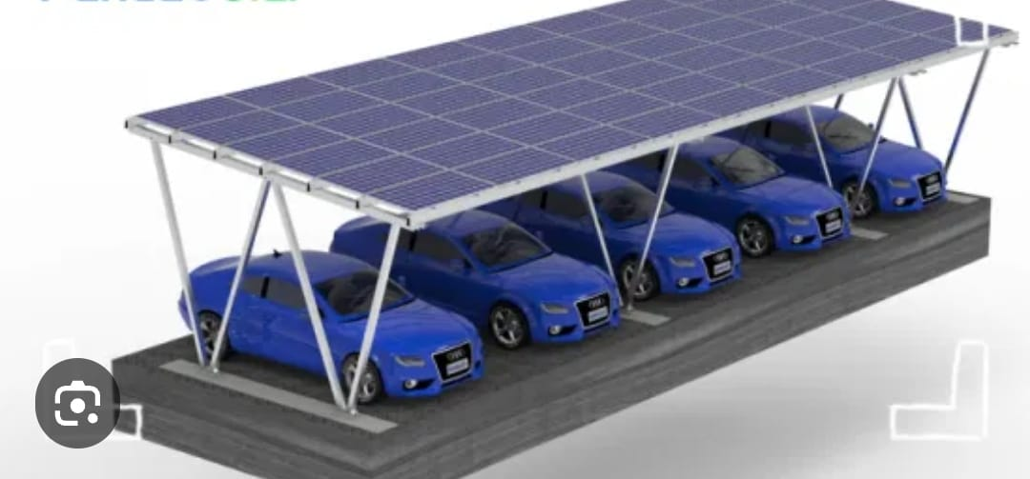
Solar carport mounting structures are employed in various settings, including commercial facilities, parking lots, educational institutions, and residential areas. Their versatility and dual functionality make them a practical choice for organizations and individuals seeking to integrate solar energy into everyday infrastructure.
Customizable Designs:
The mounting structure can be customized to accommodate various types and sizes of solar panels, adapting to specific energy requirements and available space.
Environmental Impact:
By utilizing solar energy, the carport contributes to reducing carbon emissions and the overall environmental impact associated with conventional energy sources.
Cost Savings:
Over time, the solar carport system can lead to cost savings by generating clean energy and potentially reducing electricity bills.
Aesthetic Considerations:
Some designs prioritize aesthetics, ensuring that the solar carport integrates seamlessly into its surroundings while enhancing the visual appeal of the space.
Maintenance Requirements:
The structure is designed with minimal maintenance requirements, offering a reliable and low-cost solution for sustainable energy generation.

Slide 3
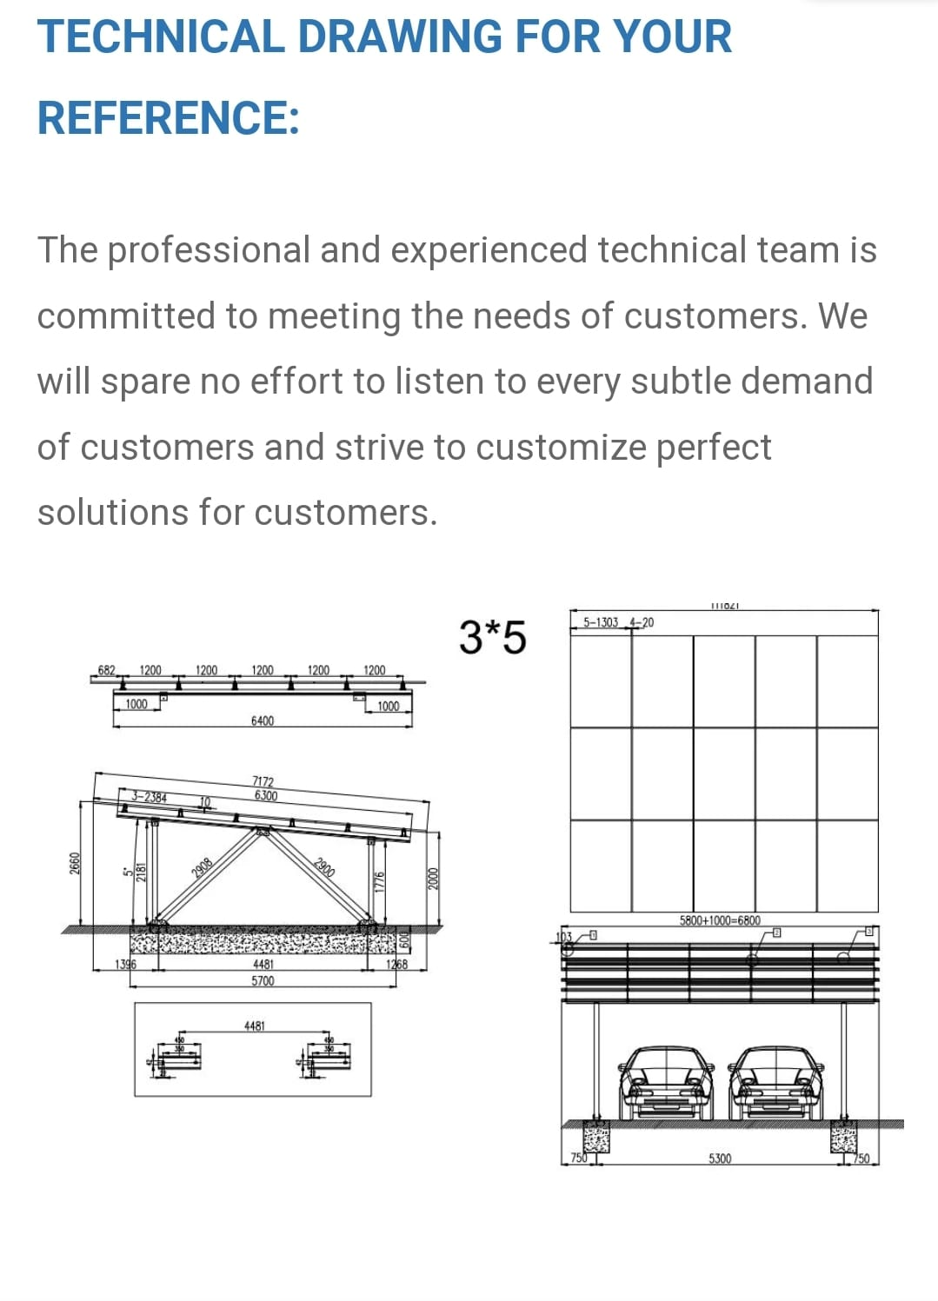
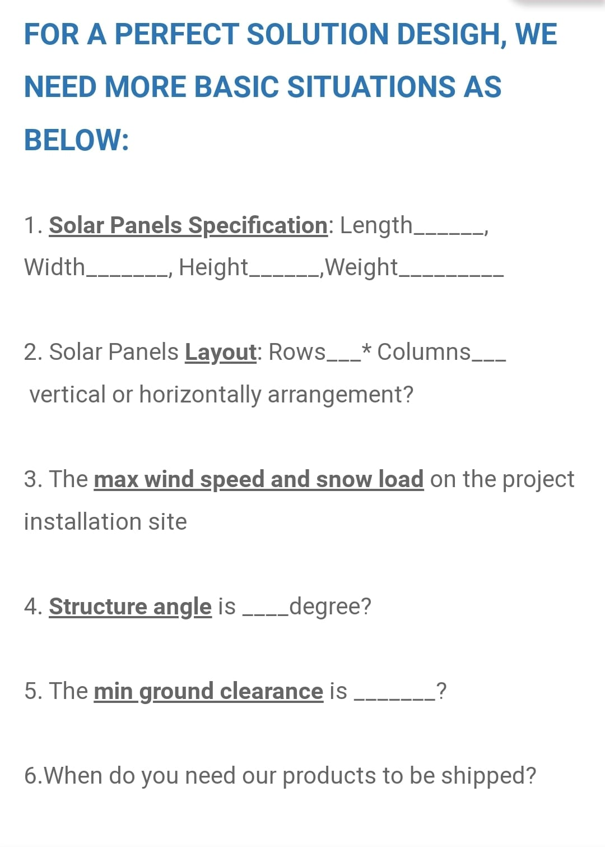

Slide 4
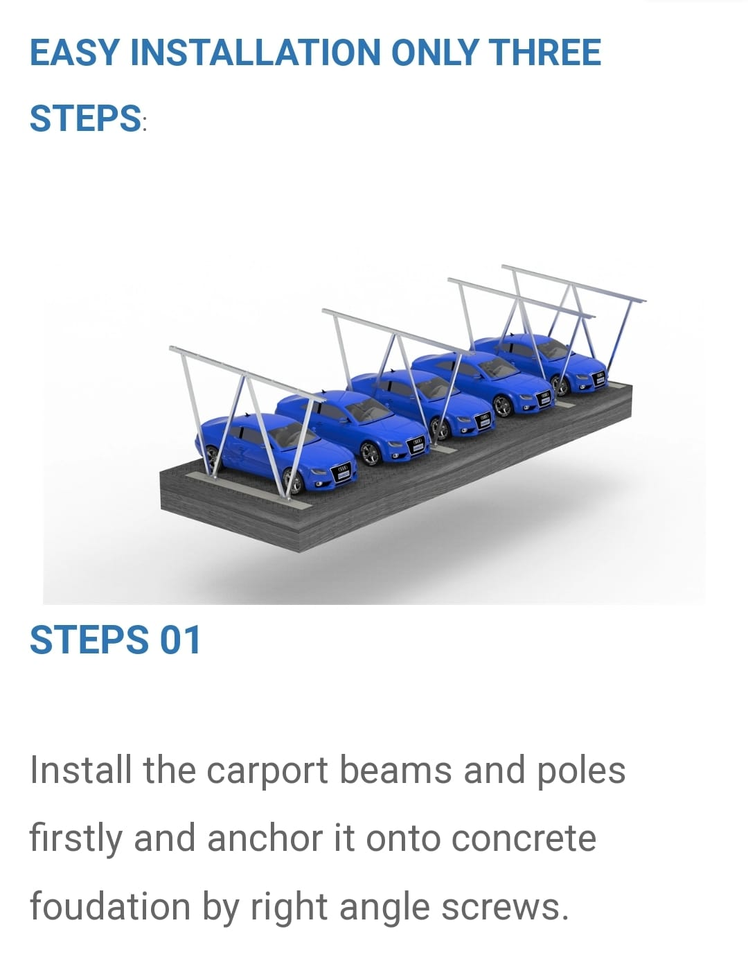
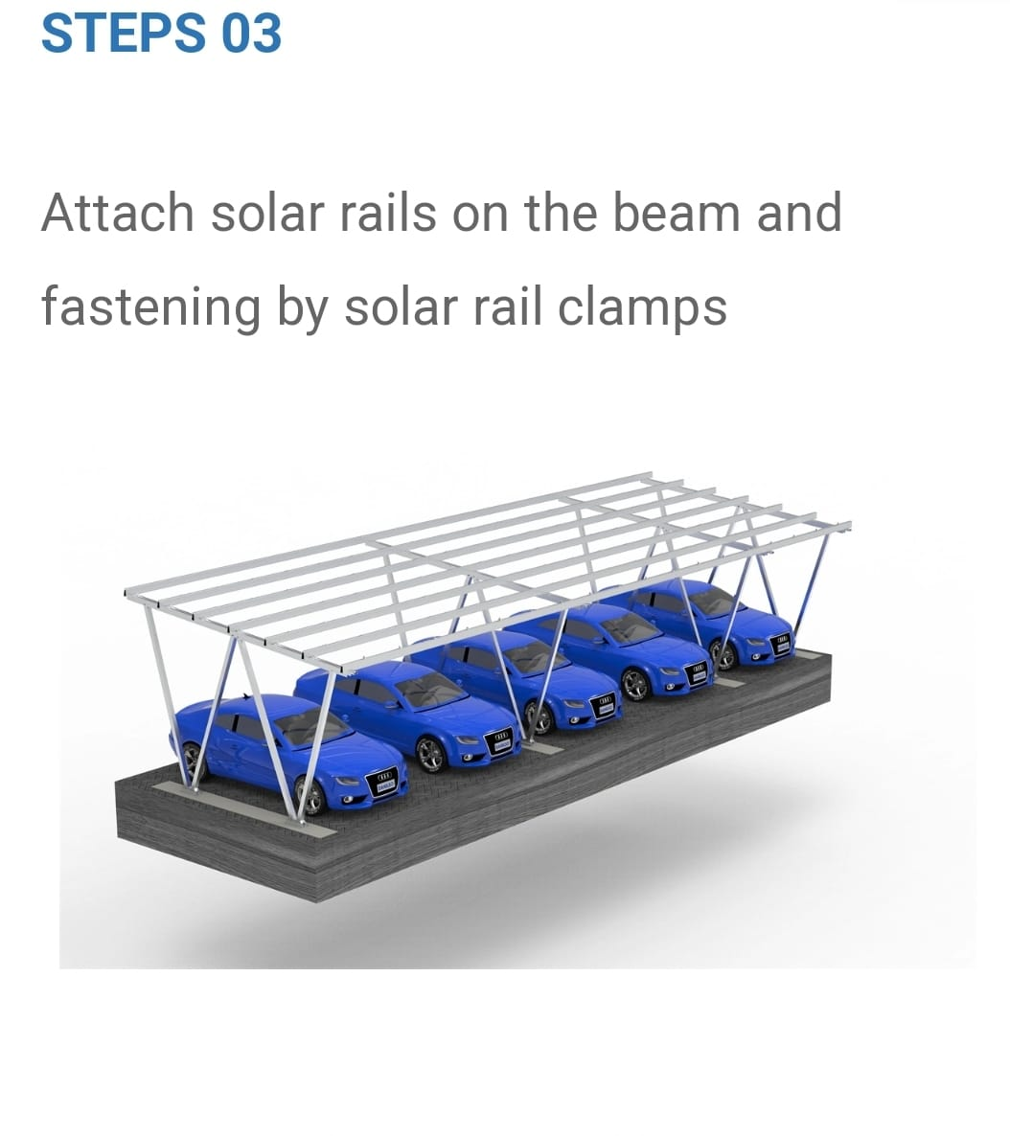
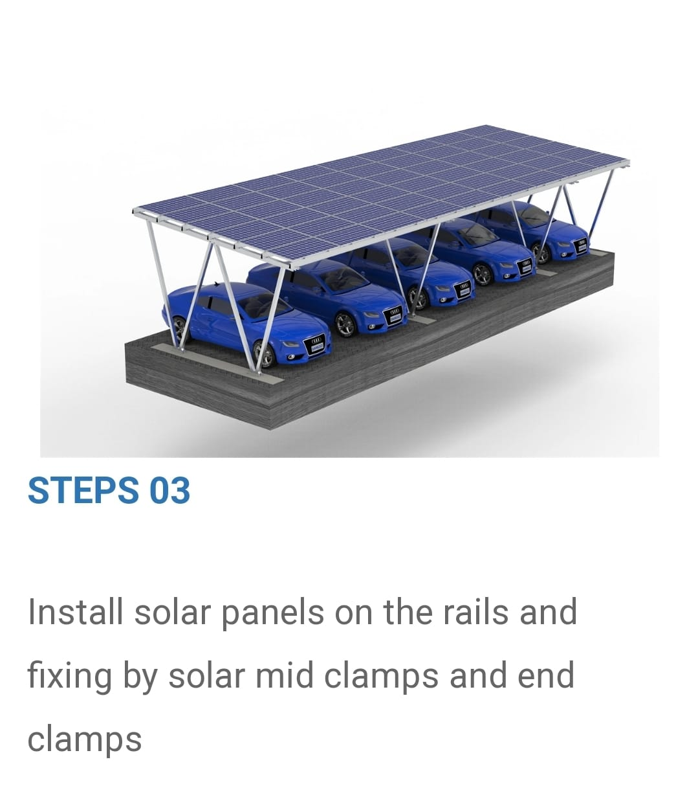

Slide 5
